Slide 1
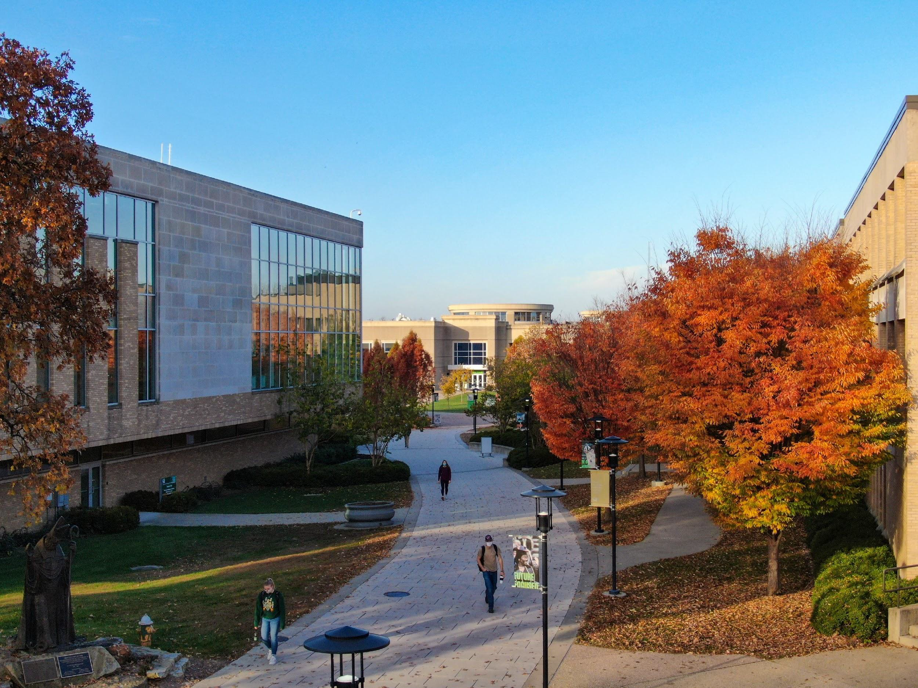
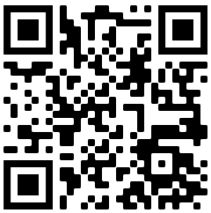
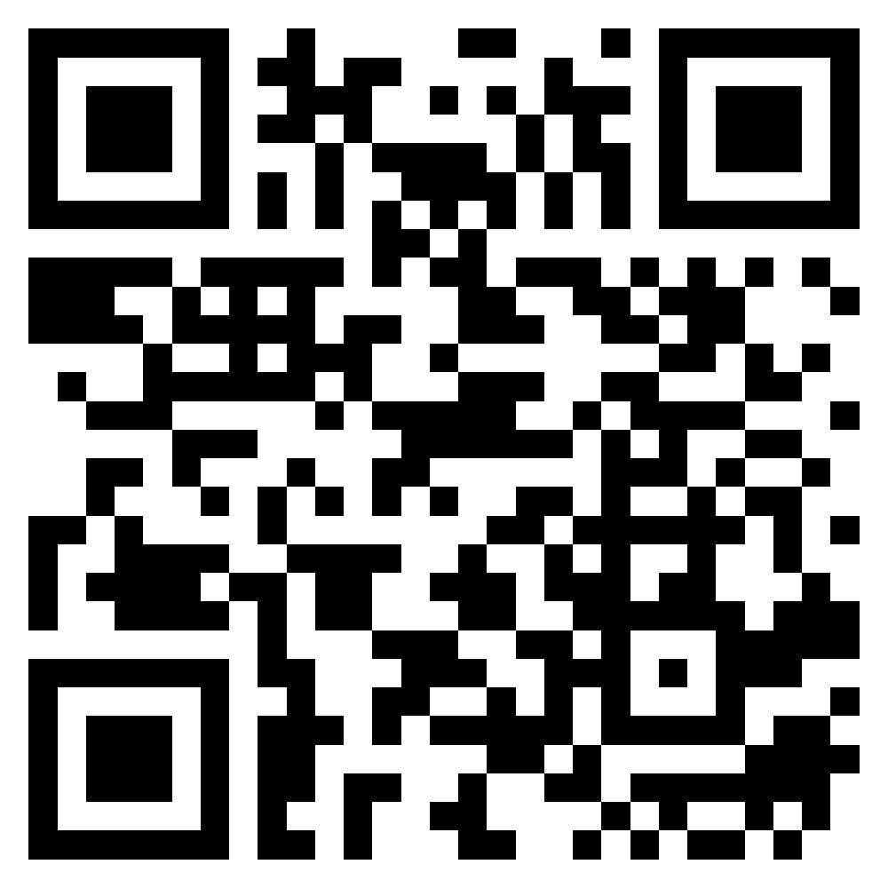
SAFB TRAINING CLUB SPORTS

Slide 2
WHAT IS SAFB
Student Activity Finance Board (SAFB)
Extension of the Student Council (STUCO)
Responsibilities Include
Managing, Collecting, and Distributing the Student Activity Fee
Giving recommendations on adjustments to the Student Activity Fee
Ensuring fiscal responsibility and use of the Student Activity Finance Funds

Slide 3
OTHER POWERS
Reallocation of SAFB funds from any group at any time with STUCO General Body approval
This is simply a tool SAFB can use to ensure fiscal responsibility and federal/state laws are followed
Place organizations under Fiscal Review
Fiscal Review is a defined process in the SAFB Code
This is usually enacted under the request of at least 5 student, of the STUCO Executive Board, of Student Involvement, or at the discretion of SAFB
This almost always comes before funds would be forcibly reallocated
Other procedures can be found in the SAFB Code
Voting Procedures
Representation Requirements for Recommendations
You must have a representative at the meeting for recommendation approval
Final Student Activity Fee Recommendations
Activity Fee Incident Procedures

Slide 4
THE BASICS

Slide 5
FUNDING GROUPS
Direct Student Funding Group (DSF)
This is the direct separation of the activity fee
Some RSOs receive direct student funding
DSF groups are eligible to receive up to 100% funding
External Funding Contributions Group (EFC)
All other RSOs who are not DSF
Subgroups of a DSF Group
Equipment & Contingency Fund Group (E&C)
– There are very specific rules to the use of this fund
*Club Sports is exempt to this rule due to being governed by a UDO that helps determine funding percentages but cannot exceed 100%

Slide 6
EQUIPMENT & CONTINGENCY FUND
The purpose of the E&C Fund:
Enable all University RSOs, excluding University-approved housing, to make long term purchases on a limited basis that cost more than a total of $5,000
Provide a contingency fund for the External Funding funds
Provide a contingency for other RSOs
This is determined based of need and feasibility of an RSO to acquire the equipment on their own or through another funding source
This is also used as a contingency
What defines a contingency can be found in the SAFB Code
Follows the rules of other equipment purchased by SAFB
If an RSO goes defunct, the equipment returns to SAFB for reallocation or resale (within the same EFC or DFS Group)

Slide 7
CAMPUS EVENTS FUND
The purpose of the Campus Events Fund is to help organizations sponsor campus events.
Athletic Director looking for Club Sports to host more events on campus
Organization and event eligibility:
Events are only eligible for recommendations up to 50% of the total event cost
The event is a recurring campus-wide event held no more than once a semester,
Occurred in the year directly prior to the request,
Will be open to all students, and
If possible, it is being held on university property.
Deadlines of Campus Events Requests are unique
Requests must be submitted at least 60 days prior to the event
Events that are to be held within the first 60 days of the semester must be requested within 40 days of the end of the prior semester

Slide 8
CAMPUS EVENTS FUND (CONT.)
Events in the summer are typically not funded
There are not enough students on campus to justify the cost
Major recruitment events for incoming freshman or during O-Week have been an exception
The event must be organized and hosted by an RSO
An RSO cannot request funds for an event hosted by a department or office on campus
Multiple RSOs can make a joint request for an event

Slide 9
WHAT IS A CLUB SPORT

Slide 10
DEFINITION OF A CLUB SPORT
During any semester, the Club Sports Council President shall generate a list of organizations that shall be recognized as Club Sports for the following semester and will submit the list to the EFC Chair no later than the 10th week of the semester.
The definition is controlled by the Club Sports Council UDO.

Slide 11
FUNDING REQUIREMENTS

Slide 12
EFC REQUIREMENTS
All University-recognized organizations, excluding university-approved housing, may receive funds.
New RSOs may receive full funding
An RSO is a new organization when Student Involvement approves its proposed constitution
It may request funds as a new organization during the first two set appropriation periods following this approval, or by special consideration approved by the SAFB
Only RSOs who have met all recognition requirements per semester are eligible for SAFB funding
All organizations may receive funds if they have a Student Council Representative
Failure to have a Student Council Representative is grounds to receive no EFC funding

Slide 13
EFC REQUIREMENTS (CONT.)
If an organization previously received funding:
For requests with a total budget below $1000, the organization must have spent within $200 of the total
For requests with a total budget between $1000 and $5000, the organization must have spent at least 80% of the total
For requests with a total budget above $5000, the organization must have spent within $1000 of the total
The board recognizes that there are some extenuating circumstances:
File an Appeal Form with the SAFB before any EFC application deadline
An SAFB Chair will hold an official review with a representative of the organization in question.
The SAFB will issue an official written ruling to the organization in question, approved by a two-thirds (⅔) majority of the SAFB.

Slide 14
EFC REQUIREMENTS (CONT.)
If an organization misuses Student Activity Fee funds or the Student Involvement purchasing protocol the organization will be required to appear before the Board and a Student Involvement representative to explain their actions
In addition:
The SAFB will write a formal ruling on the consequences, if any, that the organization may incur
– The SAFB may revoke an organization's ability to receive funding for a maximum of two semesters per incident
Student Involvement must approve the ruling of SAFB
Organizations are also subject to any existing University of Missouri System protocols for the misuse of funds

Slide 15
CLUB SPORTS REQUIREMENTS
Each Club Sports group shall electronically supply the following to the Club Sports Council when submitting the Club Sports application in the fall semester of each year:
A copy of the current semester's budget including all sources of income and expenditures (TRACK THIS NOW!)
A copy of the upcoming semester’s budget including all expected income and expenses
Signatures from the organization's treasurer, president and faculty advisor
Early in the fall and spring semester, the Club Sports Council Treasurer will make themselves available to assist Club Sports in preparing their budgets.
Funds for Club Sports appropriations shall come from the Club Sports Fund of the Student Activity Fee.
The final day to purchase items from a semester budget will be December 31st and June 30th of the same fiscal year.

Slide 16
CLUB SPORTS REQUIREMENTS
Funds requested for an expense judged to be the responsibility of individual members of the organization including but not limited to athletic competitions and training trips must benefit the entire group of members attending from the organization and shall be governed by the Club Sports Allocation System.
The organization must provide a minimum of two price quotes (when possible) for each line item that is over $100 that the organization is requesting.
– The lowest price quote must be accepted for equipment requests unless the requesting organization can show just cause to accept another quote, which may be approved through the Student Involvement Director or the SAFB.

Slide 17
CLUB SPORTS REQUIREMENTS
Any Club Sport or group of Club Sports may request funds to be set aside for a piece of required equipment.
The total cost of this item must be less than the amount required in the E&C. Appropriated funds shall roll over to the following semester, at which time it may be increased.
The amount set aside cannot exceed the amount originally proposed for the total cost of the equipment.
The allocated amount must be used for the item that the funds were originally set aside for, unless all organizations involved in requesting funds agree to change the item, the SAFB votes by a two-thirds majority to change it, and Student Council approves the change.
If the rollover line-item amount is not increased or spent in three years, the funds will be put back into the Club Sports Fund.

Slide 18
USAGE & EXTENSION OF FUNDS

Slide 19
USAGE & EXTENSION OF FUNDS
Equipment approved by Student Council through Club Sports Fund for an organization must be a one-time purchase lasting for at least three years, have a permanent on-campus storage place, and be used by the organization to achieve their mission
If no storage space is available on-campus for equipment and an organization has planned for off-campus storage
At any time, if an organization decides that it no longer needs the equipment, ownership shall revert to the Club Sports Fund account.
The SAFB will work with Student Involvement to dispose of these items as they see fit.
Funds from the Club Sports Fund must be spent within the academic semester they were approved
If an organization can show just cause as to a need for the funds to be available for more than the academic year allocated, then the organization must file an extension form.
Extended funds may not be extended again.

Slide 20
RESTRICTED FUNDING ITEMS

Slide 21
RESTRICTED FUNDING ITEMS
The following items are not to be funded by the Club Sports Fund:
Food and refreshments for regular meetings;
Deficits incurred by the organization;
Any expenses incurred prior to the approval of funding;
The purchase of alcohol;
Off-campus activities if adequate facilities are available on campus;
Fundraisers;
STILL PUT THESE ON YOUR BUDGETS
We need to know your total budget to give the best recommendation
Travel
Club Sports is permitted to use SAFB funds on travel as these typically take up more than 50% of a sport’s total budget for most of the accounts.
SAFB will sometimes redline travel is all recommended funds can be fully spent before being applied to travel.

Slide 22
UPCOMING & FUTURE DEADLINES

Slide 23
DEADLINES
The Club Sports Fund application deadline will always be the close of business on the tenth week of each semester.
The SAFB shall advertise the Club Sports Fund and the application deadline for at least two weeks prior to the day on which all applications are due.
Additionally, the SAFB will notify the Club Sports Council President about the upcoming deadline.
The Clubs Sports Council shall be responsible for receiving and reviewing any requests.
The Club Sports Council shall review all applications and records and shall submit its recommendations to the SAFB.
SAFB will then submit its recommendation to the Student Council Executive Board.
After STUCO Exec approves, it moves to STUCO General Body for final approval
From deadline to approval takes about 1.5 – 2.5 weeks

Slide 24
DEADLINES
Club Sports budgets are submitted on a semesterly basis for the following semester through MinerLink
Fall 2023 Budgets due Friday, March 24th at 5:00 PM
NO EXCEPTIONS will be made
Extension requests due Friday, April 28th at 5:00 PM

Slide 25
Questions
For more questions, please reach out to
safb.mst.edu

